Slide 1
Plan, Design, Develop, and Test Report Application
Module Project
Module : NICF-Application Implementation (SF)
Course : Application Implementation
Start Date : 20 August 2022
End Date : 22 August 2022
Submission Date : 23 August 2022
Learner Name : Ida Bagus Ketut Yoghantara
Enrollment ID : BDSE04-0322
Presentation Date :

Slide 2
Contents
Document History
Version Number | Effective Date of release | Summary of Included Changes | Author
1 | 4th March 2016 | First Edition | Satya CVS
2 | 23rd Jul 2018 | Changed for Module 6 | Shrinivas K R

Slide 3
Contents
Contents
S. No. | Description
01 | Different Types of Testing
02 | How Different Testing Helps
03 | Tests Selected
04 | Test Schedule
05 | Test Results
06 | Testing Tools
07 | Project Milestone & Tasks
08 | Milestone Feedback & Action Taken
09 | Modifications Made Based on Feedback
10 | Project Results
11 | Proposed Improvements

Slide 4
1. Different Types of Testing
List types of Testing
Unit Test Unit tests are very low level and close to the source of an application. They consist in testing individual methods and functions of the classes, components, or modules used by your software. Unit tests are generally quite cheap to automate and can run very quickly by a continuous integration server.
Integration Test Integration tests verify that different modules or services used by your application work well together. For example, it can be testing the interaction with the database or making sure that microservices work together as expected.
Functional Test Functional tests focus on the business requirements of an application. They only verify the output of an action and do not check the intermediate states of the system when performing that action.
End-to-end Test End-to-end testing replicates a user behavior with the software in a complete application environment. It verifies that various user flows work as expected and can be as simple as loading a web page or logging in or much more complex scenarios verifying email notifications, online payments, etc...

Slide 5
1. Different Types of Testing
List types of Testing
User Acceptance Testing Acceptance tests are formal tests that verify if a system satisfies business requirements. They require the entire application to be running while testing and focus on replicating user behaviors.
Performance Testing Performance tests evaluate how a system performs under a particular workload. These tests help to measure the reliability, speed, scalability, and responsiveness of an application.
Smoke Testing Smoke tests are basic tests that check the basic functionality of an application. They are meant to be quick to execute, and their goal is to give you the assurance that the major features of your system are working as expected.

Slide 6
2. How Different Test Helps
Unit Testing 1. Helps developer write better code 2. It helps developer to catch bugs earlier 3. It makes the code more easy to refactor
Integration Testing 1. Helps in identifying integration issues between the modules 2. Improves test coverage and provides an additional level of reliability 3. helps in ensuring that the integrated modules work properly before moving to the system testing of the complete application
User Acceptance Testing 1. Keeping ongoing maintenance costs as low as possible 2. Increase end-user happiness 3. Increasing software robustness and usability

Slide 7
3. Tests Selected
List the testing methods selected to test the project
Unit Testing
User Acceptance Testing

Slide 8
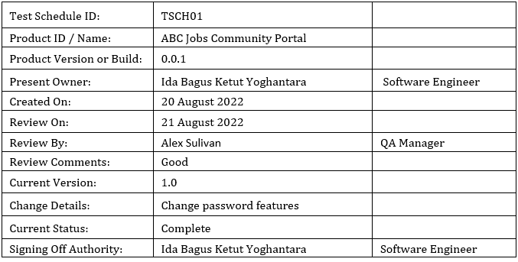
4. Test Schedule
Test Schedule:

Slide 9
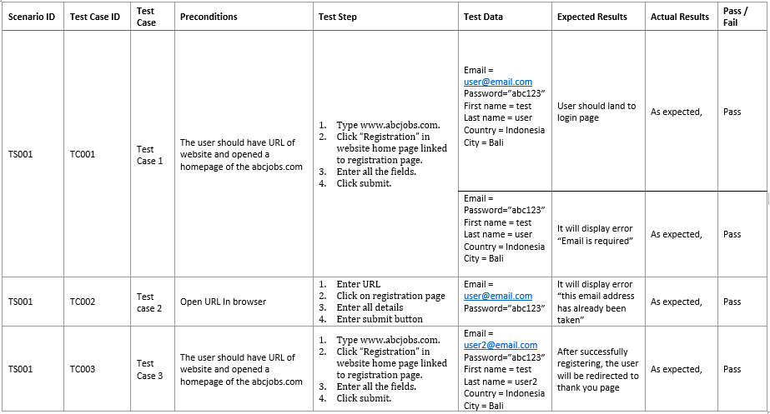
5. Test Results
Unit Testing

Slide 10
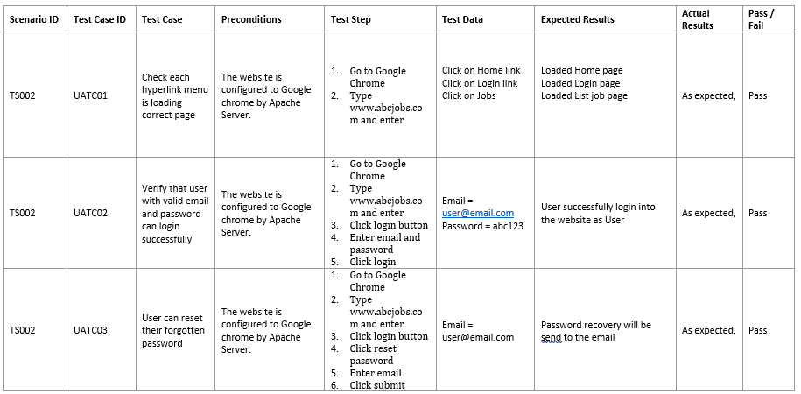
5. Test Results
User Acceptance Testing

Slide 11
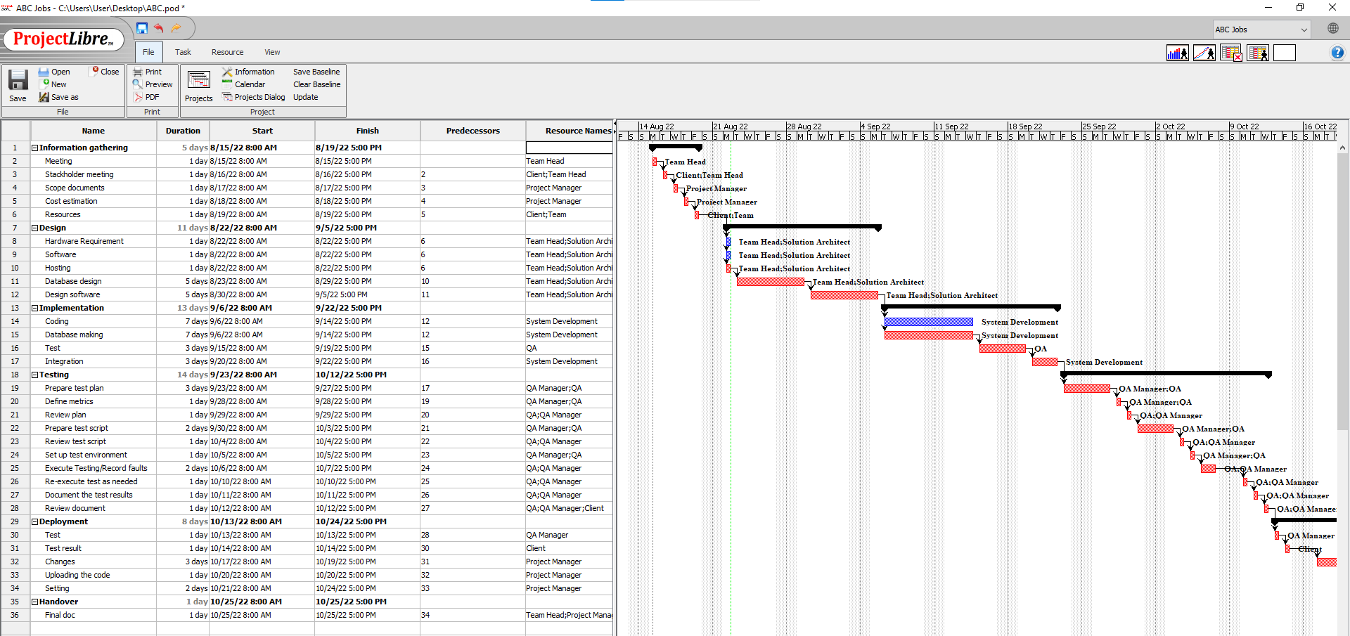
6. Testing Tools
Testing Tools
Project Libre

Slide 12
7. Project Milestones & Tasks
Project Task ID | Project Task Description | Project Milestone ID
1 | Analyze and suggest choice of Test Methods | 1
2 | Schedule the Test Optimally | 1
3 | Develop the Phase Test Plan | 1
5 | Develop Test Cases & Scripts | 2
6 | Execute the Tests & Document the results | 3

Slide 13
8. Milestone Feedback & Action taken
Project Milestone ID | Milestone Feedback received from Tutor / Learning Facilitator | Action Taken (Yes / No)
1 | Adding the tools & platform used in project report and presentation | Yes
2 | Revise Task 1 of the project report | Yes
3 | Revise the implementation of waterfall model in project report | Yes

Slide 14

9. Project Results
List of evidence 1. Project Report 2. Project Presentation 3. Test Results

Slide 15
10. Proposed Improvements
List of Improvements
Improving my knowledge about testing

